Slide 1
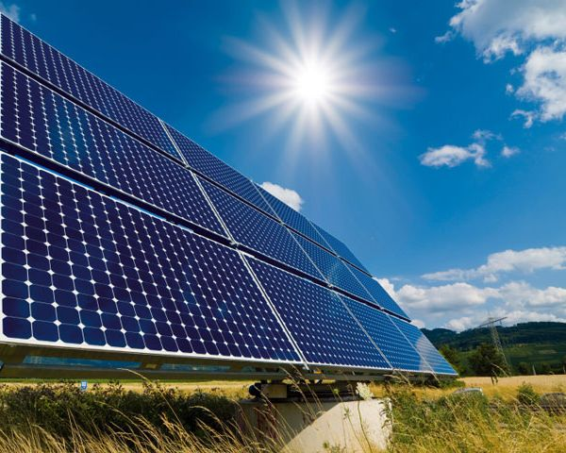
Generation Source
PV BCES INTERCONNECT
TO BCES GRID
CAUTION: Bottom Terminals
of Generation Meter will be
Energized from BCES’s
Electrical Grid
Generation Meter
Utility Meter
Junction Box
Fused
Disconnect
Cust
Panel
Grid-Tie
Inverter
Note 2
Drawing Notes:
An approved Interconnection Application and Behind the Meter Agreement, shall be presented to BCES, before any work can begin on solar installation.
AC Fused Disconnect – Disconnect handle shall be lockable in the open position and accessible to BCES personnel. Disconnect shall be fused or otherwise configured to protect the generation circuit. The fused side of the disconnect should be connect to the DC/AC Inverter. Disconnect must be within ten (10) feet of the meter base for the Generation Meter. Shall use weatherproof label “GENERATION DISCONECT.” Disconnect may be installed further from meter base when necessary but only with BCES’s approval.
Additional AC Disconnect Required for 277V and Higher – Locate as near to the Generation Meter as practical. Consult BCES’s meter representative for approved location. Connect the supply terminals to the wring that connect to BCES’s grid. Disconnect enclosure shall be lockable by BCES.
DC/AC Inverter – Inverter shall meet the requirements of UL 1741. It does not produce and send power to the BCES grid when the grid is down and shall be reset no less than ten (10) minutes after the grid is restored.
Meters – All meter bases shall be furnished and installed by the customer’s electrician. BCES will furnish and install all meters. Connect AC Power Fused Disconnect to the top lugs of the Generation Meter. Shall use weatherproof label “GENERATION METER.”
Generation System –The cost and installation of entire system shall be the responsibility of the customer. The entire system installation shall meet all requirements of the NEC, including article 690, and shall be inspected by the state electrical inspector.
The wiring connection to the customer’s panel shall be to a breaker in the customer’s panel. The breaker should be size according to the load. The electrical inspector will determine if size is correct.
System must display hard permanent placard adjacent to solar system with drawings of system installed (As Built).
Solar system must have system installation Instructions on site of installation & readily available.

Slide 2
BCES Solar Points
Solar Points
Customer or solar installer request solar for a BCES customer.
Signed BCES Application and Interconnection agreement.
Diagram of the project with size, location etc
BCES will check out diagram and location, customer. Diagram must be approved prior to construction beginning.
Once everything checks out BCES will give permission to proceed.
Solar installer will inform BCES once they start installation.
BCES will check as the install proceeds.
Solar installer will buy electrical inspections and the installation must past inspections.
Rough in, Passed.
Service release, solar can be turned on after service release passes, for 45 days.
BCES will do a final inspection and if it is approved. BCES will notify to electrical inspector.
Final inspection, when passed.
BCES sets meter after passing final.
Approved by Inspector
Updated: 8/5/2021
K:\Front Office\Templates\Overhead Temporary. Pdf (CSR)
K:\Administrative\BCES Service Policies\Customer Reference Sheets\Overhead Temporary.ppt (Editable)

